Slide 1
Lesson 2
CAN Basic Frame
Notes:
1) Xin chao moi nguoi, cam on moi nguoi da tham gia vao khoa hoc FuSa
Buoi hom nay la ve phan session 1, overview ve FuSa
2) Truoc em cung gui tai lieu ve FuSa, anh chi em thay the nao.
Tai lieu co de hieu khong ah, cam giac FuSa co de khong ah.
3) Em xin phep buoi nay nhu chia se kien thuc, kinh Nghiem ve FuSa.
Cac anh chi em da co kinh Nghiem lau nam, nen neu co gi khiem khuyet xin cac anh chi em dai xa cho

Slide 2
Contents
CAN frame Types
CAN Standard Data Frame Format
CAN Extended Frame Format
The Classical CAN offers 11-bit (standard) and 29-bit (extended) data rates, whereas CAN FD as the name suggests, offers flexible data rates, ranging from 0-64 bytes per frame. BOSCH had developed both these technologies to support the ever-growing need for data and technology in the automotive industry.
As the name suggests, the basic or most popularly known as the classical CAN was the initial invention. BOSCH originally made a Controlled Area Network Bus (CAN Bus), a communication protocol (a digital data network) for automotive applications. With vehicles becoming innovative and multiple ECU's coming into the picture, there was a need to introduce a communication method that could justify the ever-growing demand for complexity, speed, and loads of data. With time the advancement took the beast mode, and here is when CAN bus played an essential role as it would not have been fair to lay the vehicle with kilometres of wire just for communication between different modules.
On the other hand, CAN FD was released as an advancement to the original CAN-Bus protocol when the features offered by the Classical CAN started falling short of the technology it had to support. CAN Flexible Data rate (specified in ISO 11898-1:2015) is practically a more capable CAN. This flexible signal transmission provides automotive electronics' communication with increased bandwidth and all the required functionality cost-effectively. Moreover, it offers upgradation to almost every feature CAN holds and is a better alternative for more advanced data and bandwidth requirements.
The classical CAN 2.0 bus has many features that make it an ideal choice for applications where the number of ECUs is more and the bandwidth utilization is less. Classical CAN bus supports a maximum message payload of 8 bytes per frame at a maximum data rate of 1Mbps. CAN FD supports a flexible message payload, ranging from 0, 8, 12, 16, 20, 24, 32, 48, 64 bytes per frame at 2, 5 and 8 Mbps of data rates. Also, the CAN FD Protocol has two independent bit rates for the arbitration and data phases. The arbitration phase uses the same bit timing as the Classical CAN, but the data bit rate is either similar or higher than the arbitration bit rate.

Slide 3
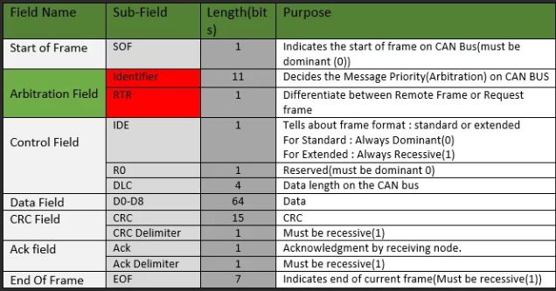
Contents
CAN frame Types
CAN Standard Data Frame Format
CAN Extended Frame Format
Standard or Classical CAN Frame
The standard frame format is specified in can Specification CAN2.0(A) by Robert Bosch. See below table for frame fields,sub-fields and its role in CAN Frame-
Note : Identifier available in standard CAN is 2048(2^11) but 2032 is available due to some implementation reason.

Slide 4
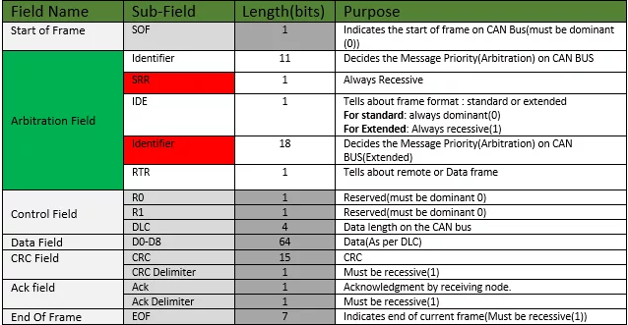
Contents
CAN frame Types
CAN Standard Data Frame Format
CAN Extended Frame Format
The extended Frame of CAN is almost similar to the standard frame except for its arbitration field. See below table for frame fields,sub-fields and its role in CAN Frame –
So as you can see Arbitration field in the extended frame format only differ from the standard CAN means extended CAN architecture designed in such a way that standard and extended CAN coexist on the same network.
Note: Available Identifier in Extended CAN is about 500 million (2^29).

Slide 5
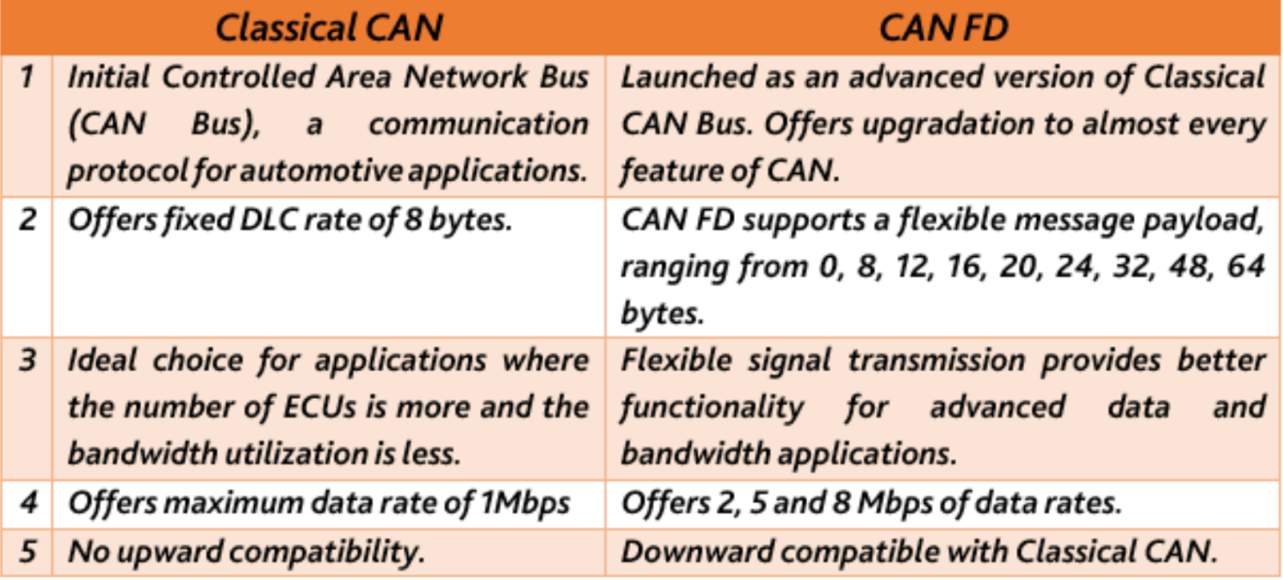
Contents
CAN frame Types
CAN Standard Data Frame Format
CAN Extended Frame Format

Slide 6
CAN Frames types - topic
How many CAN Frames type are there? (What,Why,When)
Controller Area Network (CAN) is a communication protocol used in automotive and industrial applications. There are two main types of CAN frames:
Data Frame (CAN Data Frame): This is the most common type of CAN frame and is used for transmitting data between nodes on the network. It includes the Identifier (ID), which specifies the message priority, and the Data field, which contains the actual information being transmitted. Data Frames can have a standard (11-bit) or extended (29-bit) identifier.
Remote Frame (CAN Remote Frame): This type of frame is used to request data from another node. It is similar to a Data Frame but does not contain actual data. Instead, it includes an identifier to specify which data is being requested. Remote Frames can also have a standard or extended identifier.
These two frame types facilitate communication on the CAN bus by allowing nodes to transmit and receive data as needed for their respective functions in the network.

Slide 7
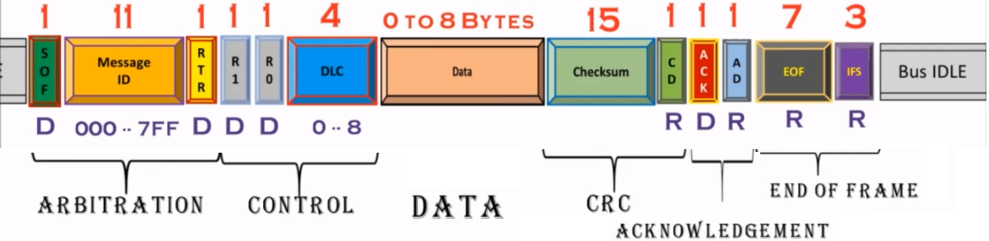
CAN Standard Data Frame Format
Explain the standard Data Frame Format

Slide 8
CAN Extended Frame Format
Explain the Extended Data Frame Format and compare it with Standard Frame Format

Slide 9
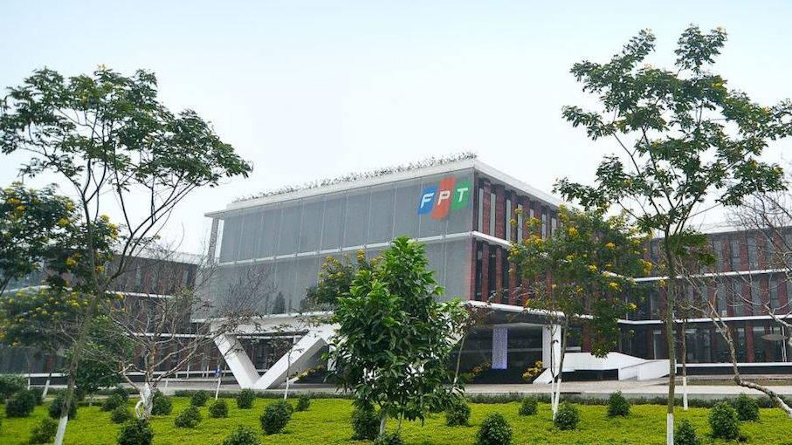


THANK YOU

